Slide 1
Product Listing process as an Amazon Seller

Slide 2
Log in as Amazon seller from Amazon website.
You may use the url: sellercentral.amazon.com/

Slide 3
After log in please follow the next instructions step by step to list your product successfully.

Slide 4
Step 1: Click “Add Products via Upload” from the “Inventory” dropdown menu

Slide 5
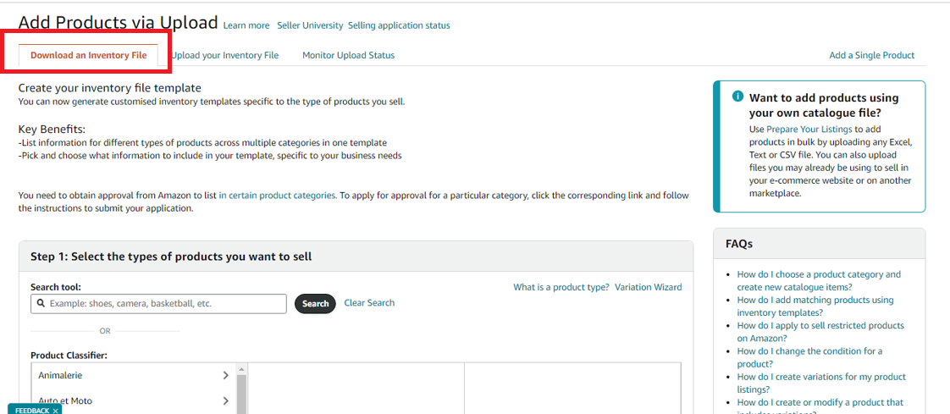
Step 2: Select “Download an Inventory File” menu from “Add Products via Upload page” and it will take you to several steps to complete the product upload process.

Slide 6
Step 3: In search tool(step 1), choose the product type (e.g.: laptop cases) and select the market places( Step 2) as per client’s instruction.

Slide 7
Step 4: Click “Generate Template” (step 3) which will generate Excel Template for listing

Slide 8
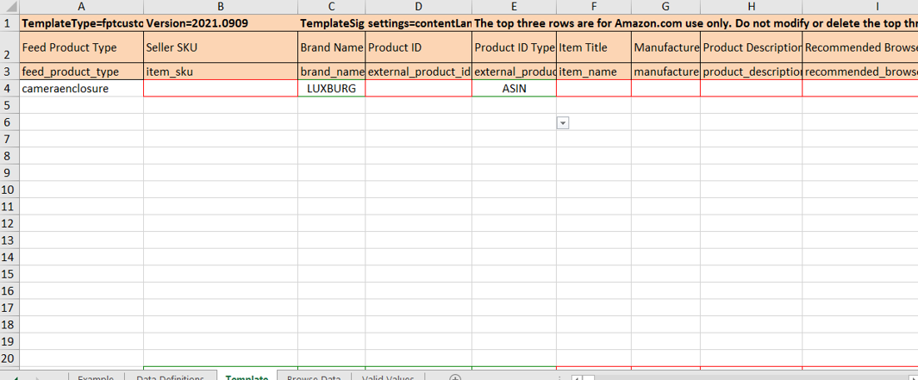
Sample of excel template that will be stored in Amazon Database. So, all information might be filled up in their respective columns correctly.

Slide 9
Step 5 : In “Upload File“ menu choose file type as ‘Inventory Files for Specific Categories” and then upload the excel file by clicking the “Upload” button.

Slide 10
Step 6: Once you complete the uploading then go to the menu “Monitor Upload Status” to view the report to know whether the listing is successful or not.( you also can download your status from here)

Slide 11
Final Step: In the downloaded excel file, we can get the following type of excel sheet. Here, the products in green rows mean, these products listed successfully and yellow one means an error. So, we have to fix the error as per the instructions from note box.

Slide 12
You can see your listed products by searching with “ASIN” number and you also can edit your listed products from the drop down option next to the listed items.

Slide 13
Thank You
Please feel free to ask any query

