Slide 1
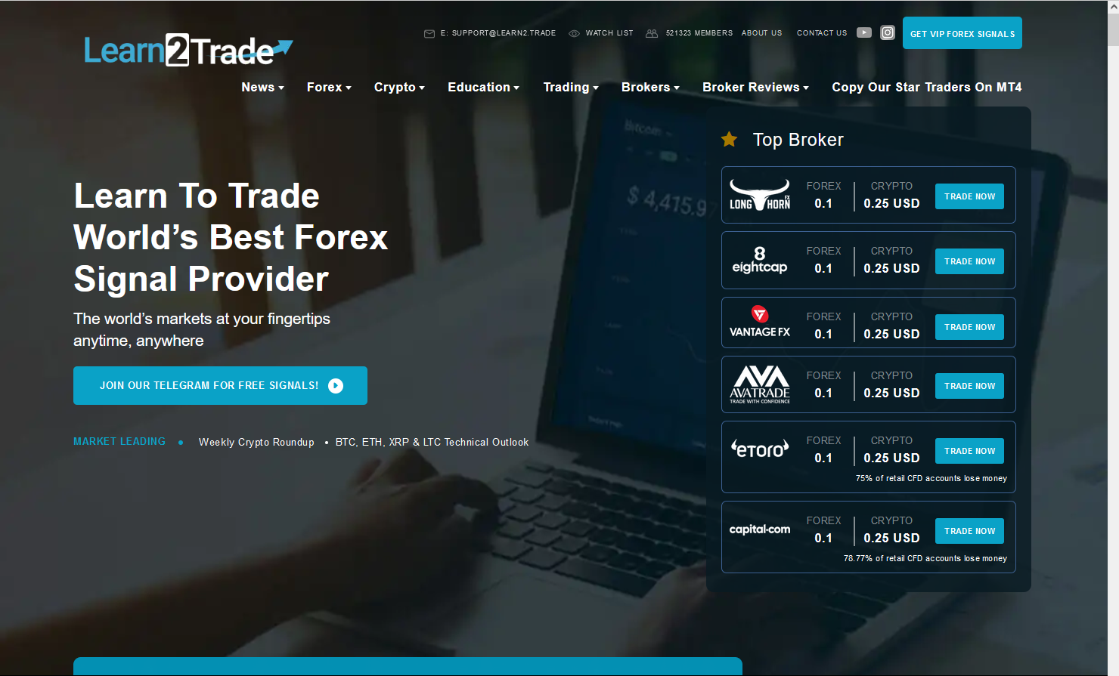

Slide 2
Get VIP Forex Signals
Home Traders Analysis Learning Center Forum FAQ About Us Contact US Login
Quality FOREX Trading Signals
For only $3 per day
Join our Telegram for FREE Signals

Slide 3
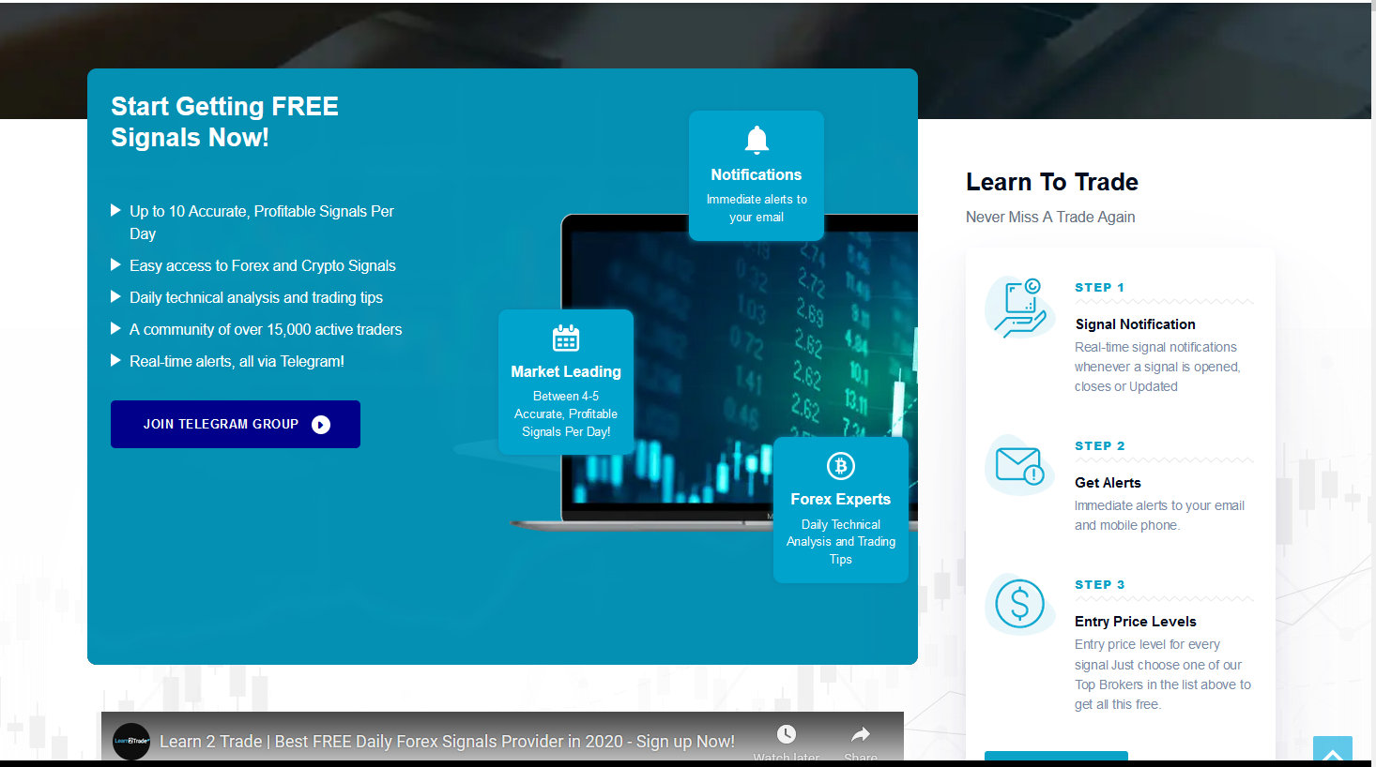

Slide 4
Is it Worth Paying $3
Per day
To Copy All our Trades
And make Profit on your Account?
Real Time Alert when we Trade
Full Trade Details, Price, Target, Stop Loss
Trading Signals on Telegram
Copy us directly using MT4 platform

Slide 6
Youtube video embed:
<iframe width="560" height="315" src="https://www.youtube.com/embed/9gGZ_VMdnBc" title="YouTube video player" frameborder="0" allow="accelerometer; autoplay; clipboard-write; encrypted-media; gyroscope; picture-in-picture" allowfullscreen></iframe>
Latest traders desk blog showing here, only last item

Slide 8
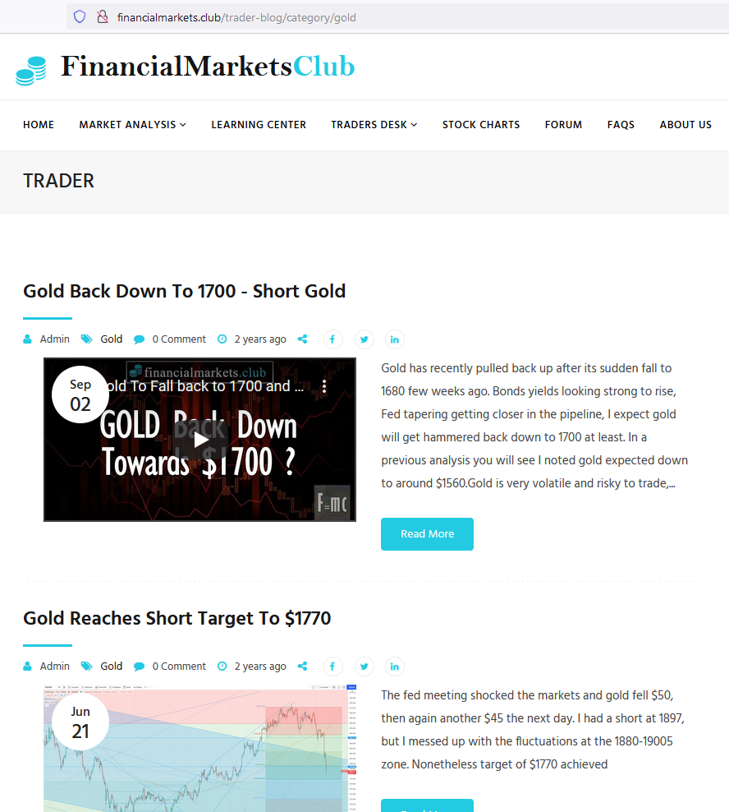
Show this page. Include all categories. Show only last 6 items

Slide 9
Remaining sections just copy the website same like it is showing.

