Slide 1
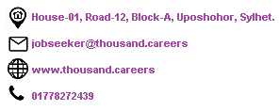
Welcome

Slide 3
We are happy to introduce our self (Thousand Careers) as one of the easy going Recruitment Agencies around you.
The work we do for you:
we help you to find a suitable job.
we help you to write a professional CV.
we help you to find a best suitable job based on your skills and desired job types.
we help you throughout the interview process.

Slide 4
CV Collection
Interview Tips and Guidelines
Take a Short Interview
Send CV’s To Employers
Final Interview with Employers
Candidates Sign Up and Apply
Make a CV Bank
Screening
Work Process of TC

Slide 5
How to be exceptional in competitive job market?
Getting a clear overview of current Job market
Build an online profile
Make a professional CV
Follow the smart ways to find suitable jobs
Apply according to given instructions
Prepare for an interview

Slide 7
Overview Of Current Job Market in Sylhet
Opportunities
Sales Jobs
Teaching Jobs
Receptionist Jobs
Computer Operator Jobs
Admin Jobs
Limitations
Lack of Opportunity
Salary Structure
Working Hour
Experience is Preferred

Slide 9
A Professional CV Contains Following Informations
List your name, address, telephone number and email at the top of the page.
Write a career objective.
Create a section for your education and qualifications.
Create a section for your work experience.
Create a section for your skills and achievements.
Create a section for your interests.
Create a section for personal information.
Create a section for references.
Don’t forget to rename your CV, e.g. Sanjit Resume, CV of Sanjit etc

Slide 10
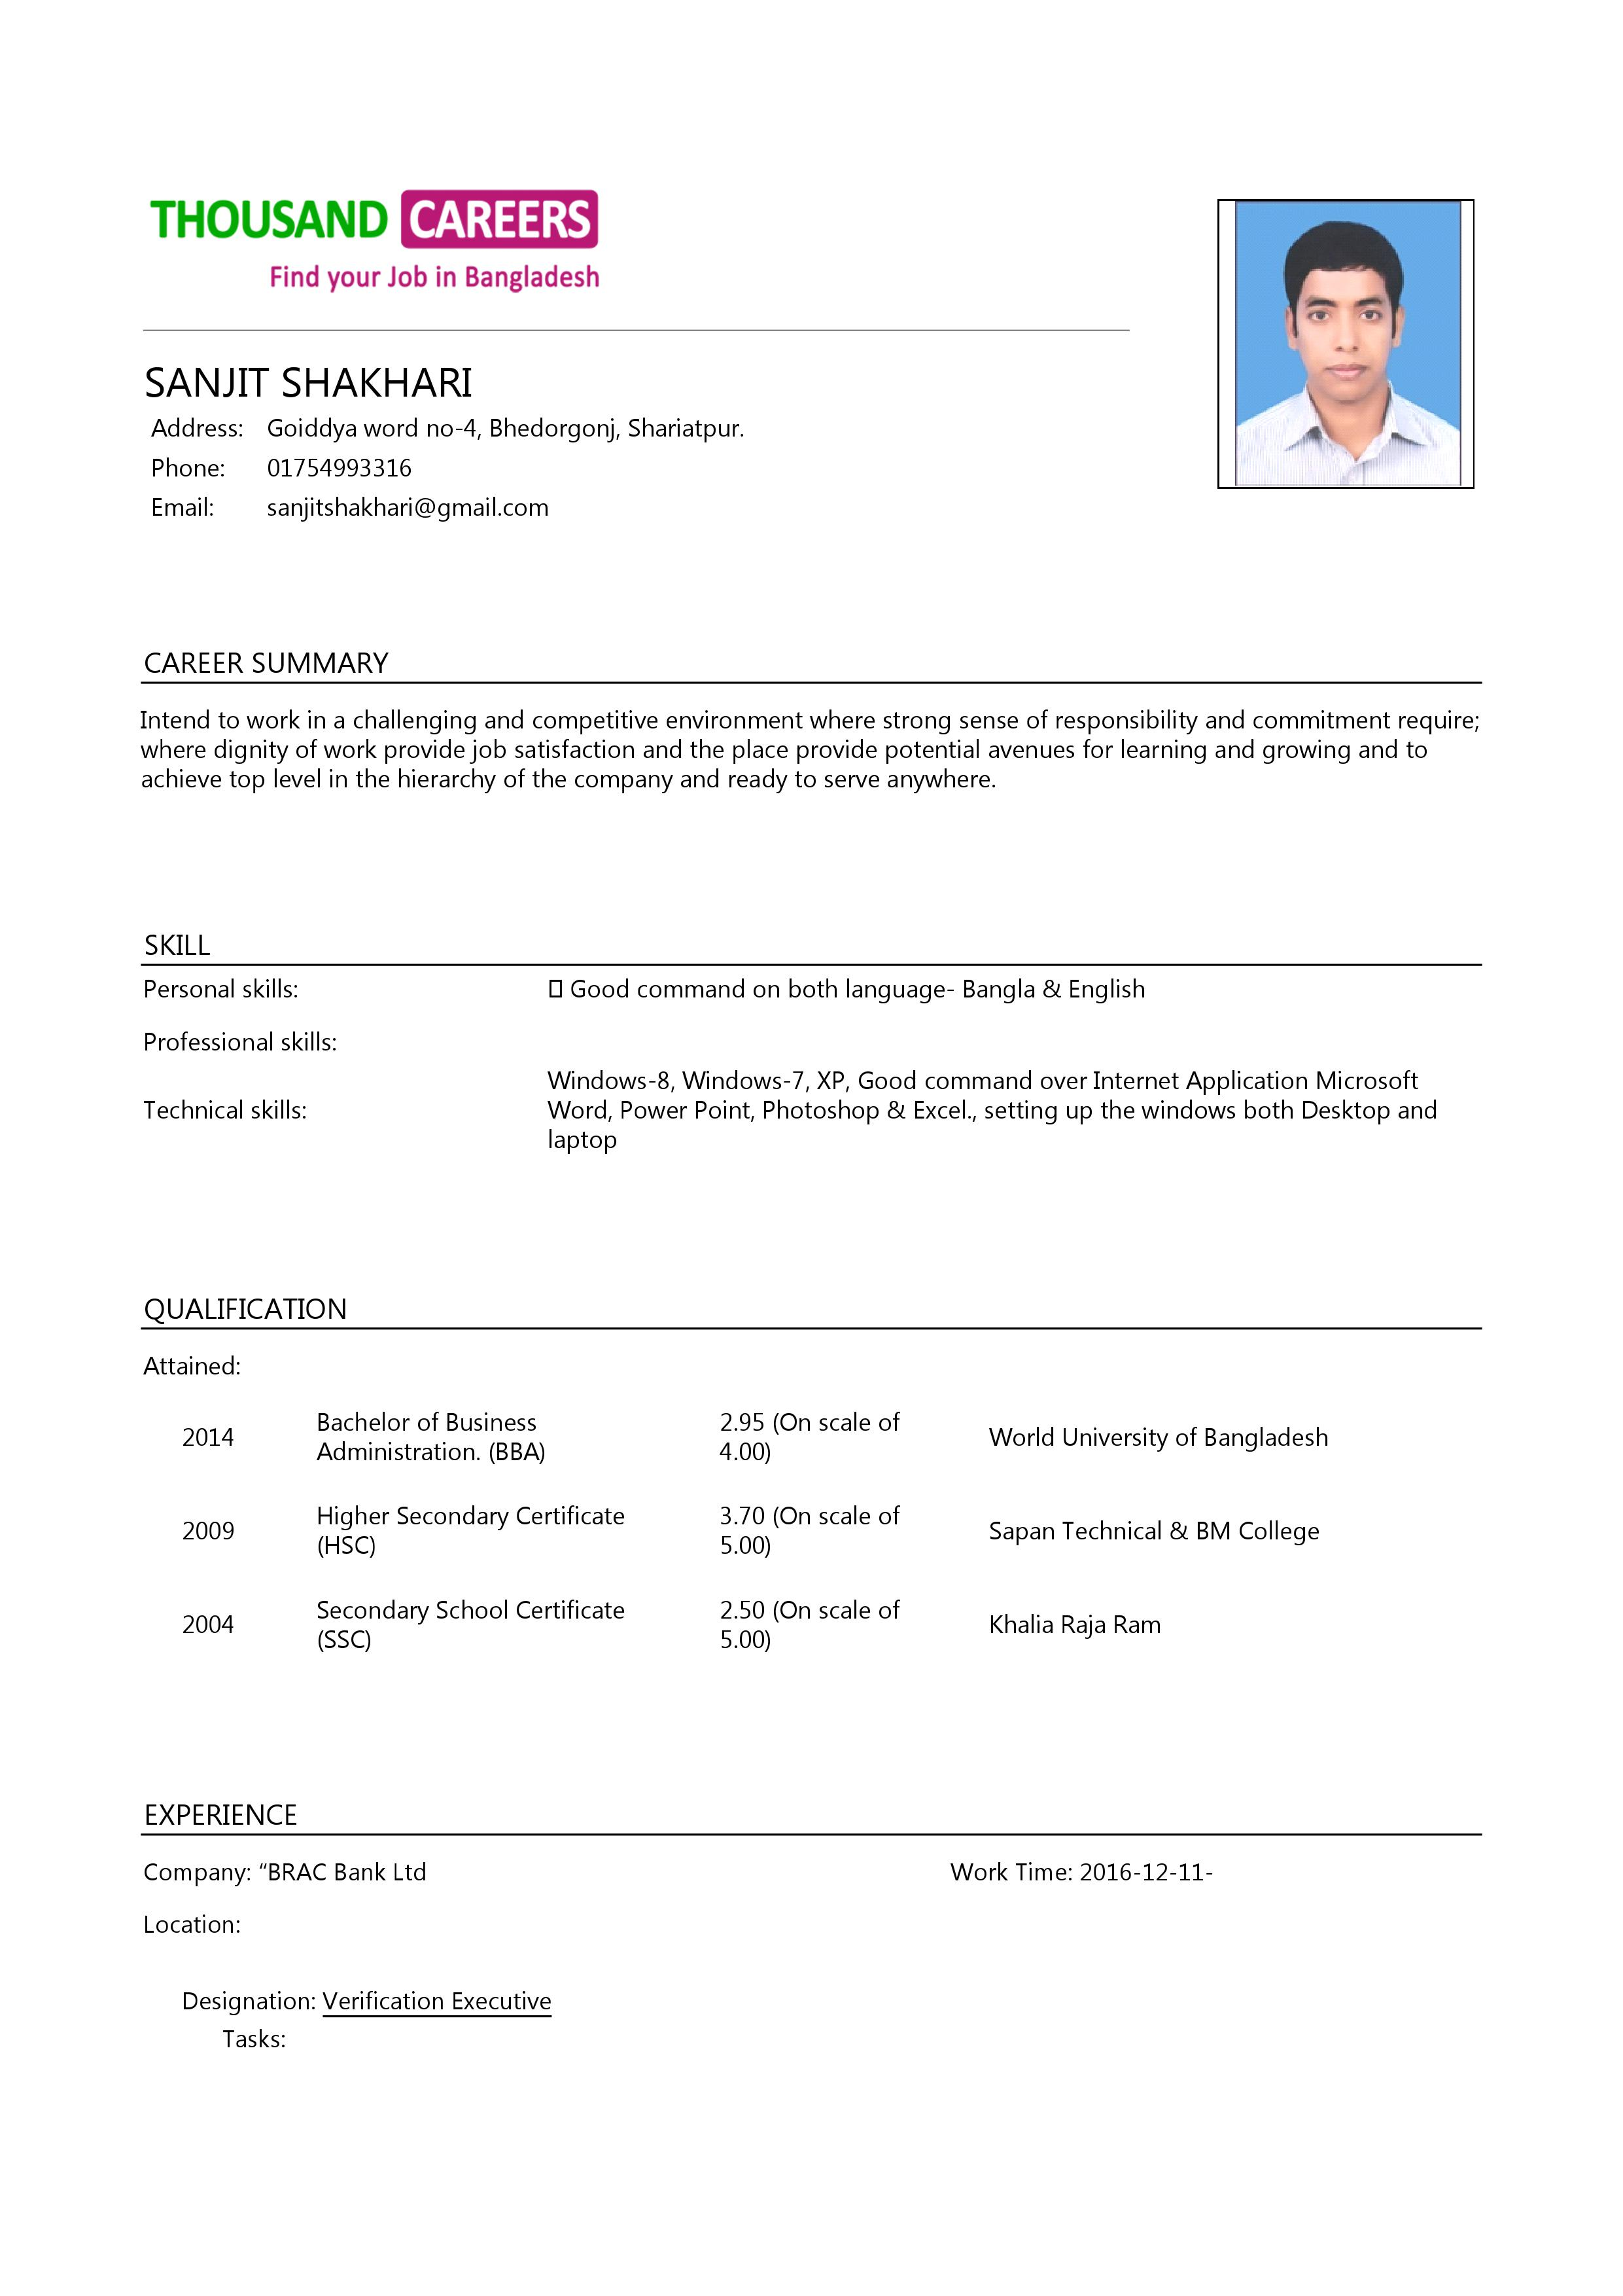
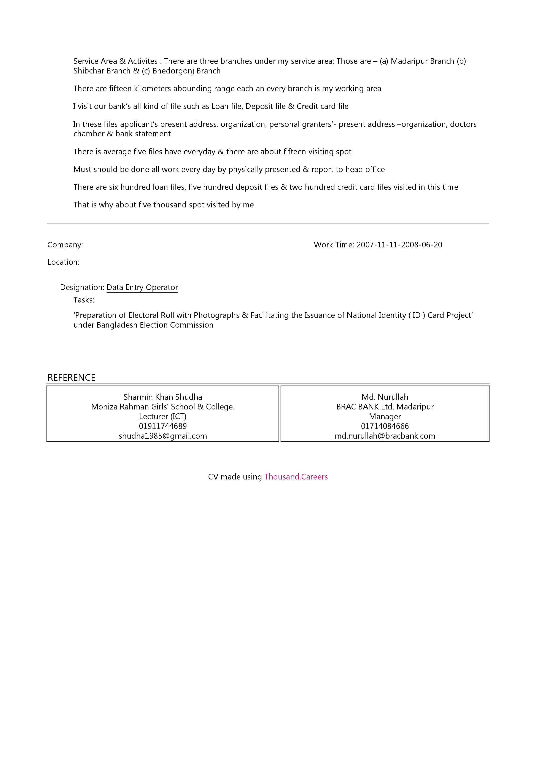
Let see a professional CV from Thousand Careers

Slide 12
Online Sources:
Job Portal (Thousand Careers)
Company Website
Facebook
Linked In
Blog
Offline Sources:
Notice Board
Newspaper
Poster

Slide 13
Best Way to Apply For a Job
Online Application
Email Application
Mail Application

Slide 14
How to Prepare For a Job Interview
Research the organization
Compare your skills and qualifications to the job requirements
Prepare responses
Plan what to wear
Plan what to bring
Pay attention to non-verbal communication

